Slide 1
Module 1: Traditional NWP Review

Slide 2
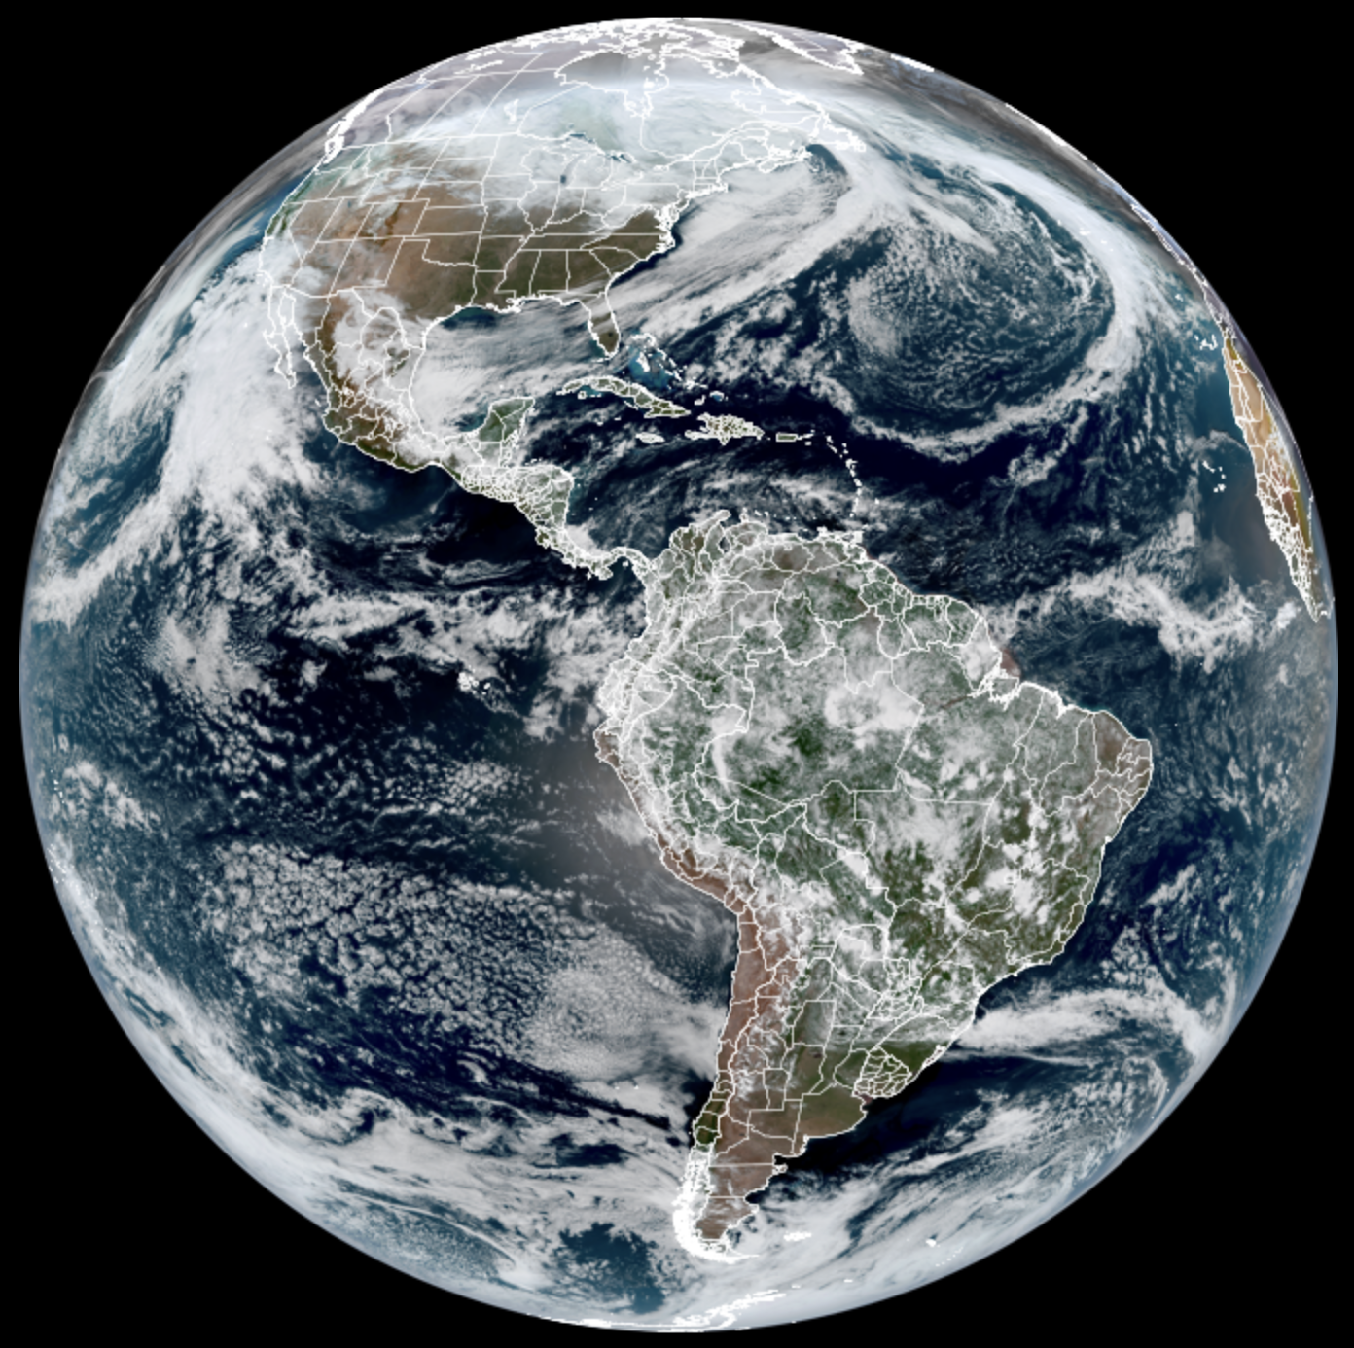
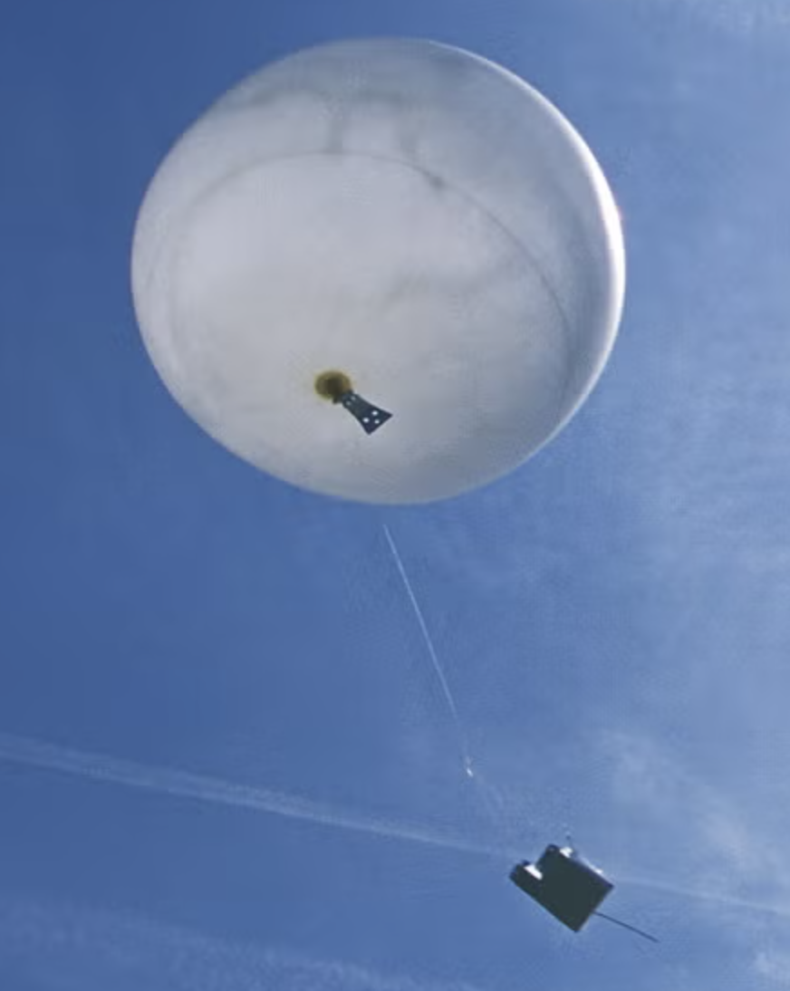
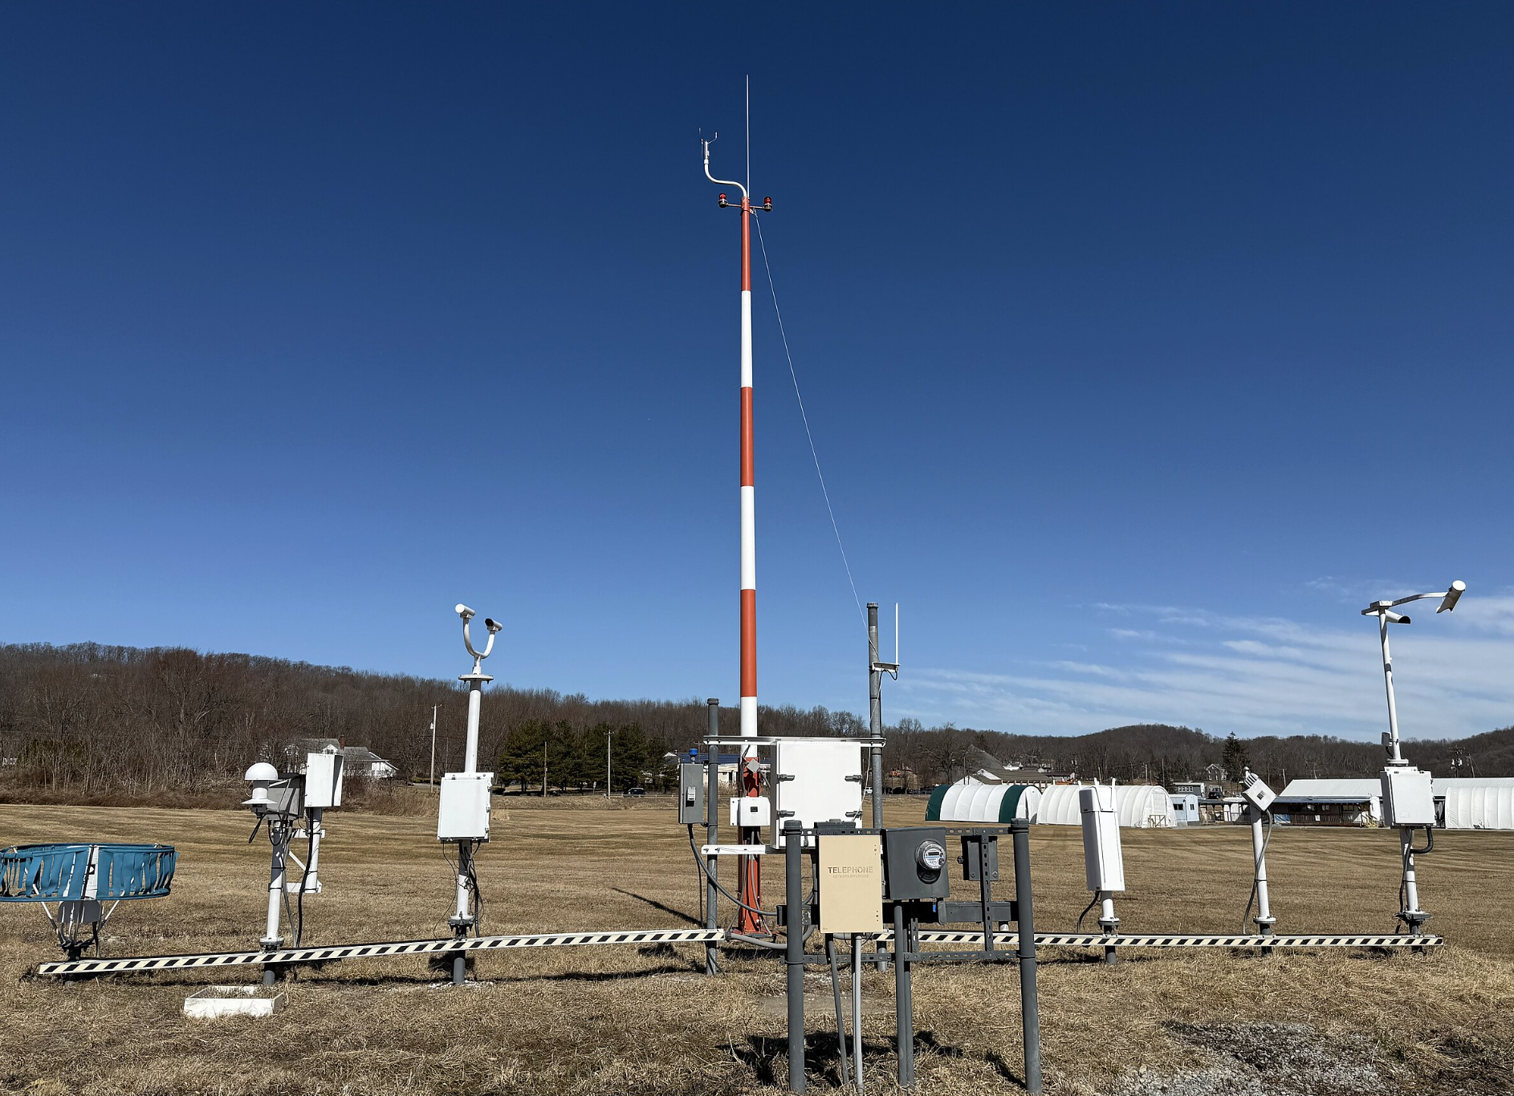
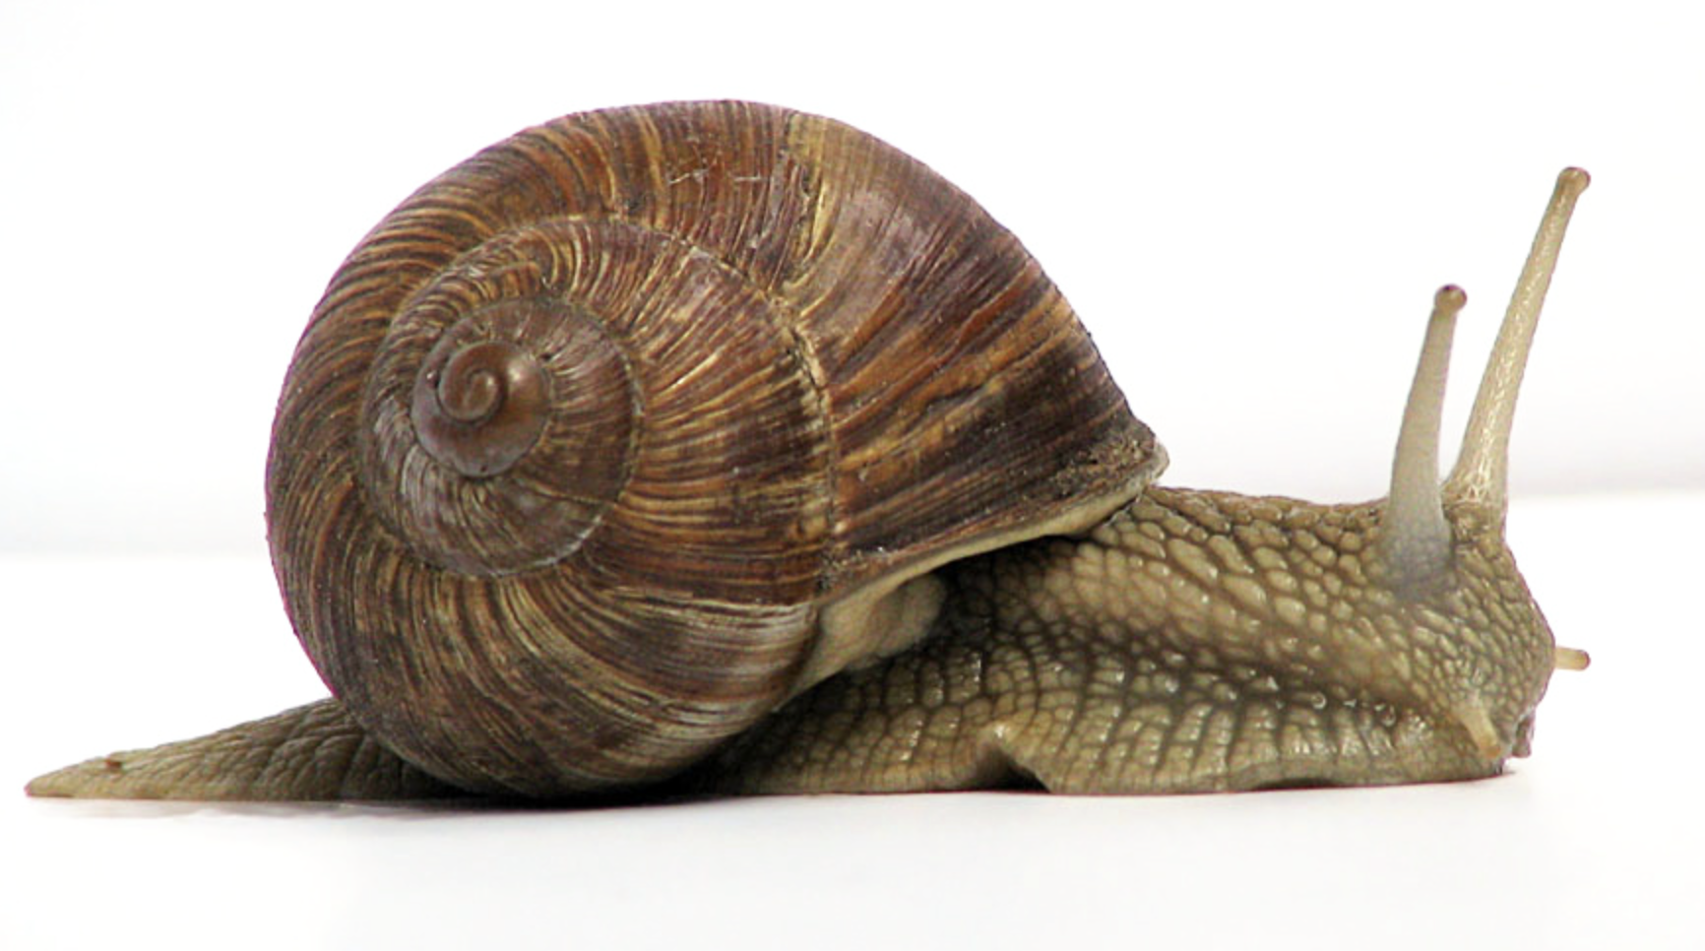
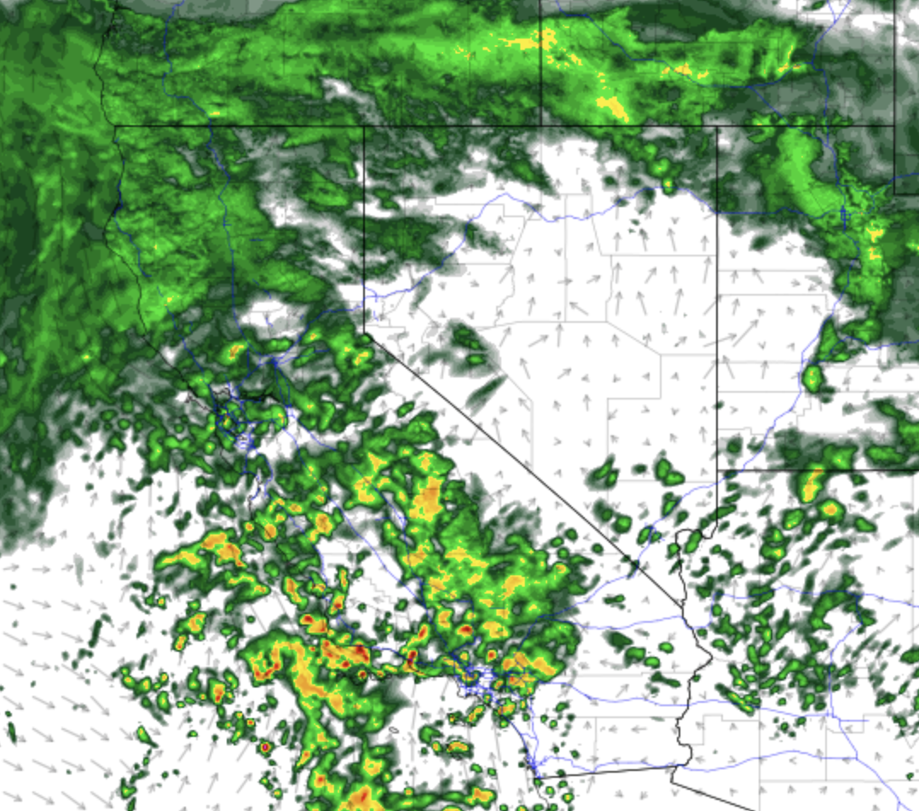
The traditional way…
CIRA/CSU
Wikipedia
Data → Analysis (assimilation)
Run model (integration + parameterization)
Write output at pre-determined interval
UCAR
Wikipedia
The Good:
Rooted in equations of motions. Outputs are usually physically explainable. Physical conservation laws are required by equations.
The Bad:
Speed. Depending on the computational resources, it can take hours on a very expensive compute cluster to generate a 2-week forecast.
The Ugly:
Parameterizations. Our best attempt at treating processes we cannot explicitly resolve.
College of DuPage

Slide 3
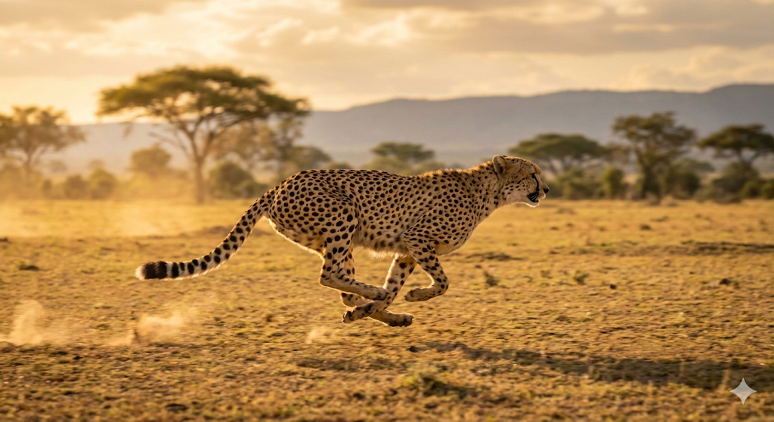
Both modeling approaches are data limited!
ML prediction…
CIRA/CSU
Wikipedia
Data → Analysis (assimilation)
Run model (integration + parameterization)
Write output at pre-determined interval
UCAR
The Good:
Speed. Anyone with a laptop can make a 2-week forecast in minutes (after setup).*
The Bad:
Blurred predictions. MSE loss functions are penalized heavily by trying to predict a tail event, so forecasts quickly lose detail. However, significant improvement in 2024/2025.
The Ugly:
Explainability. Efforts are underway to improve here, but most early ML weather prediction effort have focused on performance. I.e., If a model fails, how do you explain why it failed?
No mathematical constraints on conservation laws.
Nano Banana
College of DuPage
*Weeks required to train as a one-time up-front expense, but then inference can be run in minutes.

Slide 4
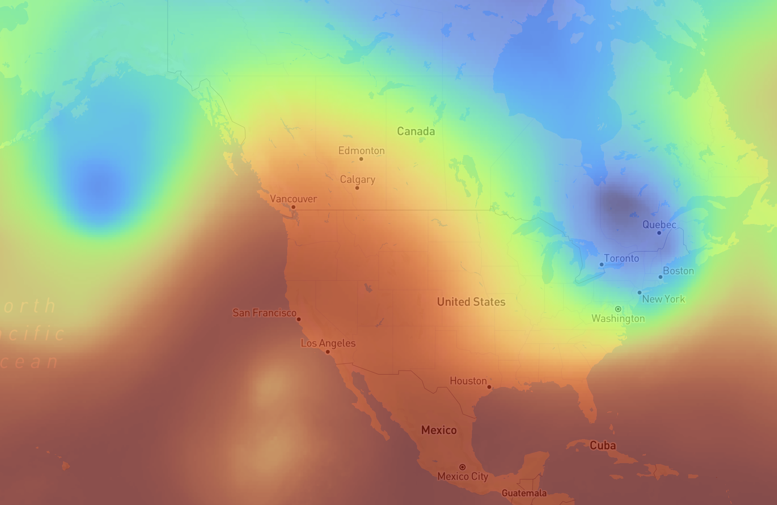
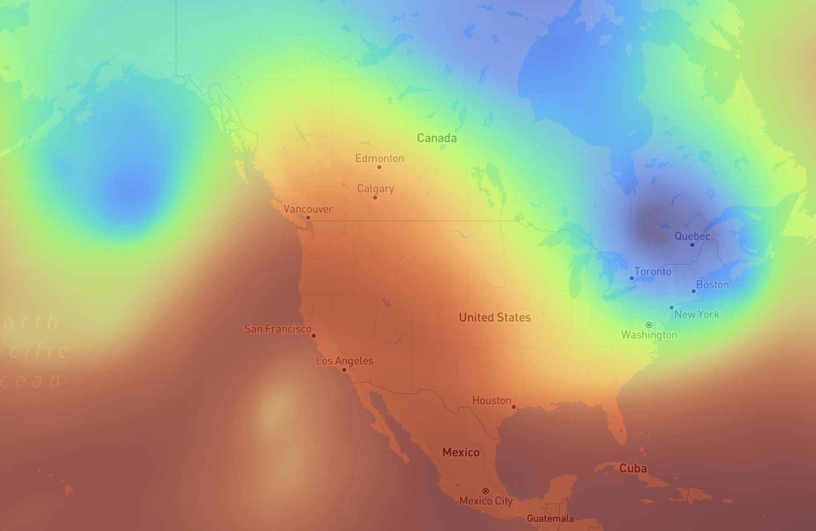
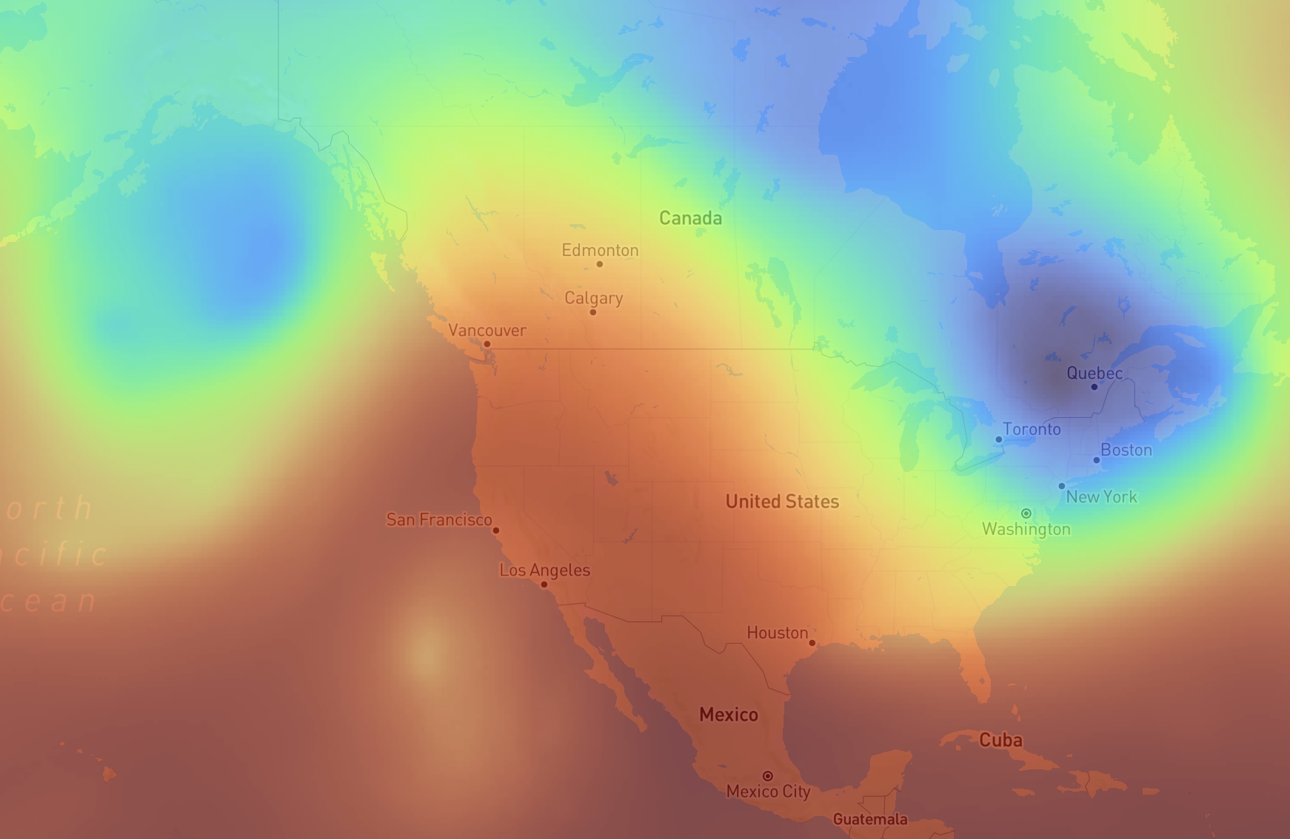
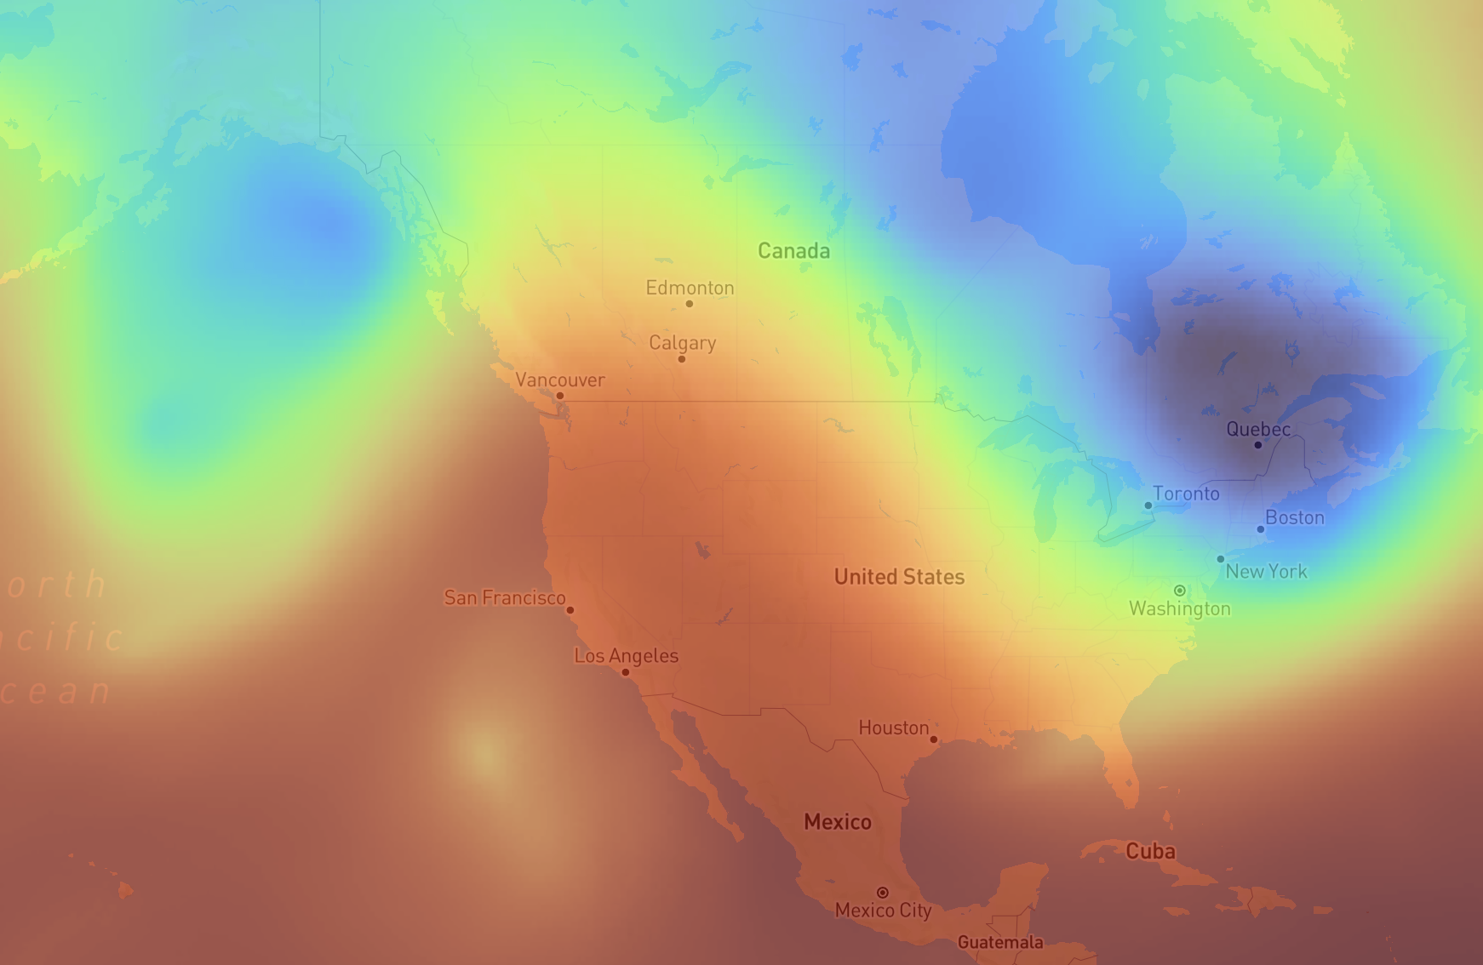
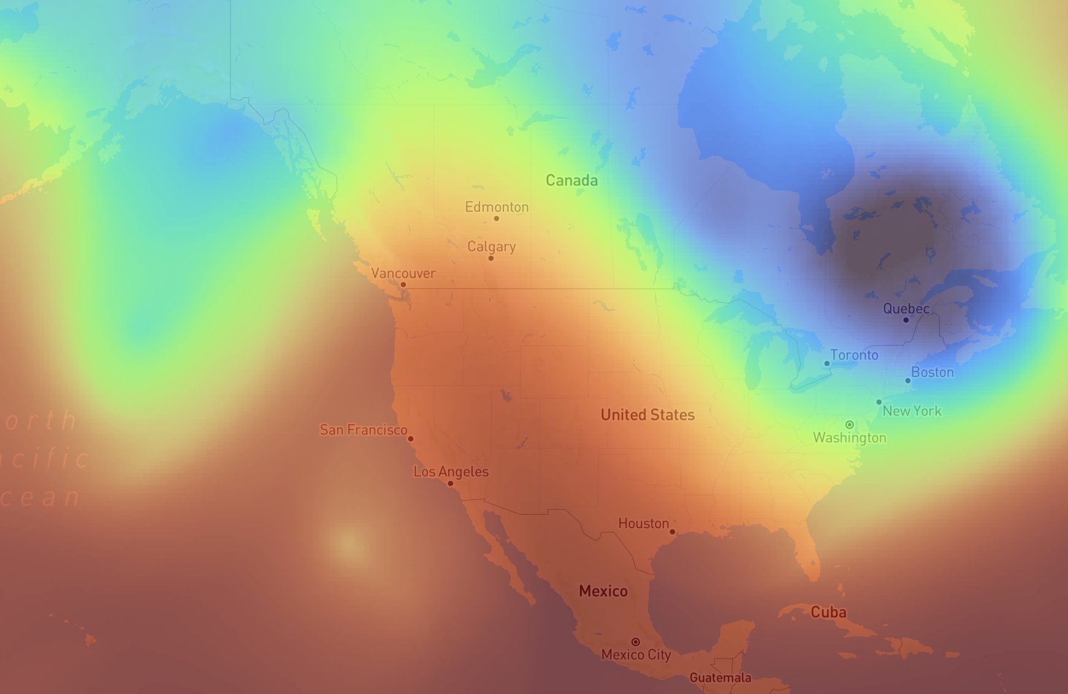
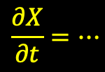
00 hr (”analysis”)
$$\frac{∂X}{∂t}=…$$
Integrate forward in time.
18 hr
06 hr
12 hr
Differ primarily in
Spatial discretization (How is grid handled?)
Temporal discretization (How does model handle time stepping?)
The traditional way…
24 hr

Slide 5
00 hr (”analysis”)
Make prediction that would have minimized mean squared error in training dataset.
18 hr
06 hr
12 hr
Minimizing the loss function and capturing multiple scales of variability has numerous diverse methods!
ML prediction…
24 hr

Slide 6
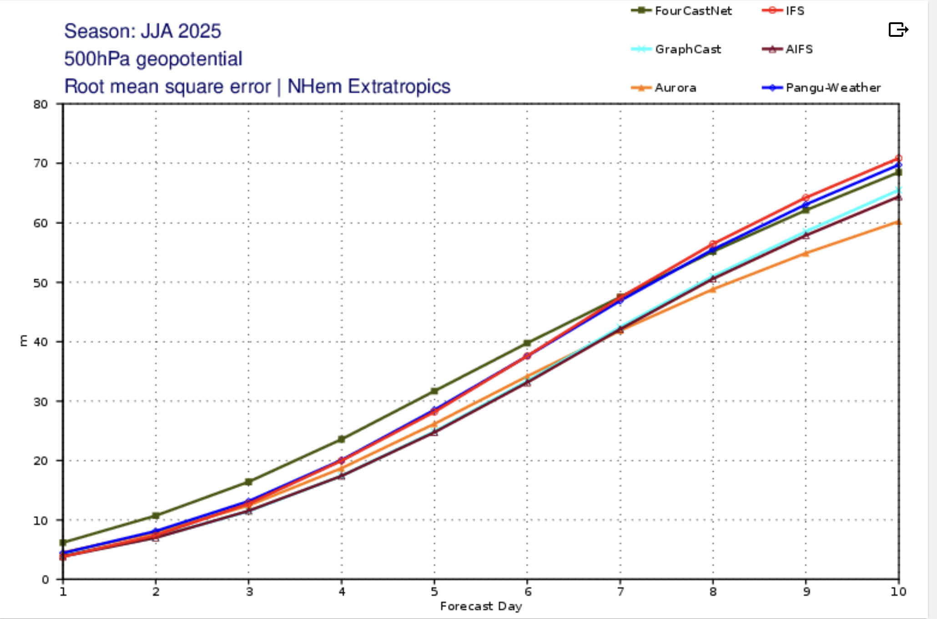
Source: ECMWF

Slide 7
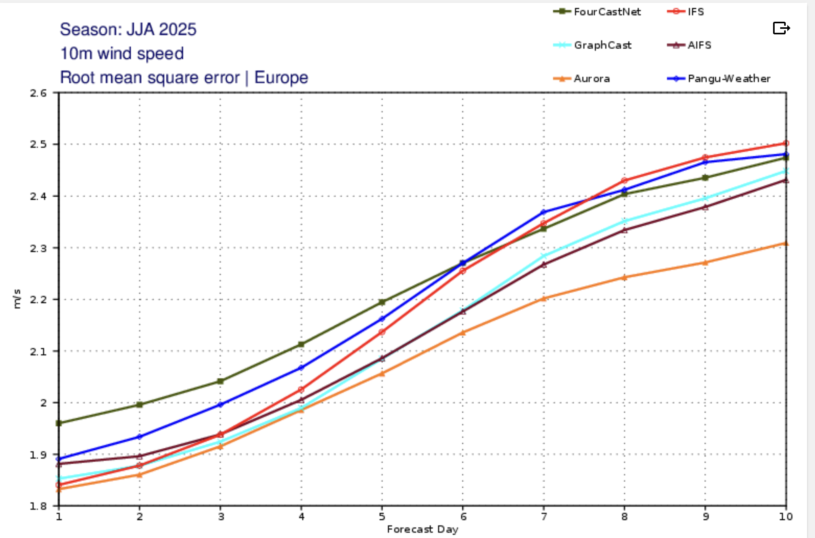
Source: ECMWF

Slide 8
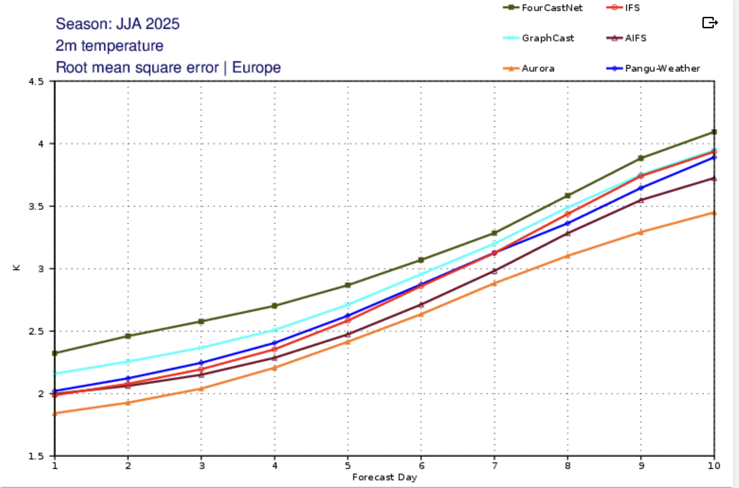
Source: ECMWF

Slide 9






How does a gridded NWP system work?
Discretize and integrate forward governing equations.
Momentum
Mass continuity
$$\frac{∂u}{∂t}=−u∙∇u+fv −g\frac{∂z}{∂x} − F_{x}$$
$$\frac{∂u}{∂x}+\frac{∂v}{∂y}+\frac{∂ω}{∂p}=0$$
$$\frac{∂v}{∂t}=−u∙∇v−fu −g\frac{∂z}{∂y} − F_{y}$$
Thermodynamics
$$\frac{∂w}{∂t}=−u∙∇w−\frac{1}{ρ_{0}}\frac{∂p^{′}}{∂z}+Bg−gq$$
$$\frac{∂T}{∂t}=−u∙∇T+ω\frac{RT}{c_{p}p}+ \frac{ℋ}{c_{p}}$$
$$\frac{∂q}{∂t}=−u∙∇q+E−P$$
The basic challenge involves how do we step forward in time?

Slide 10
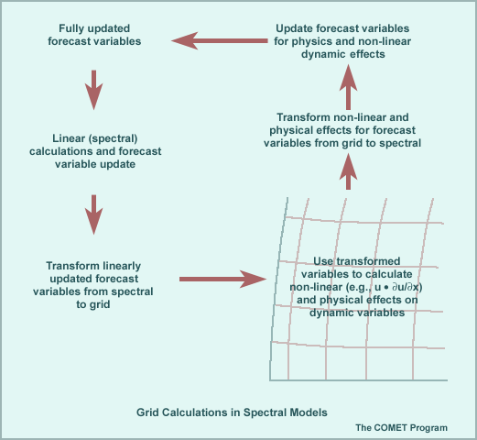
Flow Chart for Each Time Step
Computing final (n+1)Δt
equations with linear & nonlinear terms in spectral space
return (n+1)Δt
start at nΔt
compute linear terms at (n+1)Δt spectral space
FFT
Compute nonlinear terms and physics at (n+1)Δt
physical space
FFT
Source: COMET “Impact of Model Structure & Dynamics” http://www.meted.ucar.edu/nwp/pcu1/ic2/frameset.htm

Slide 11
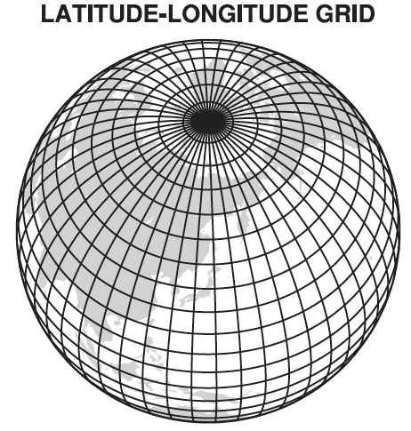
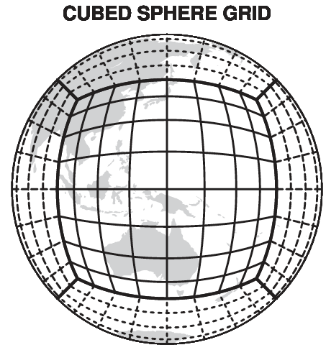
Discretization on a grid
Hexagonal grid
Many other options available too.

Slide 12
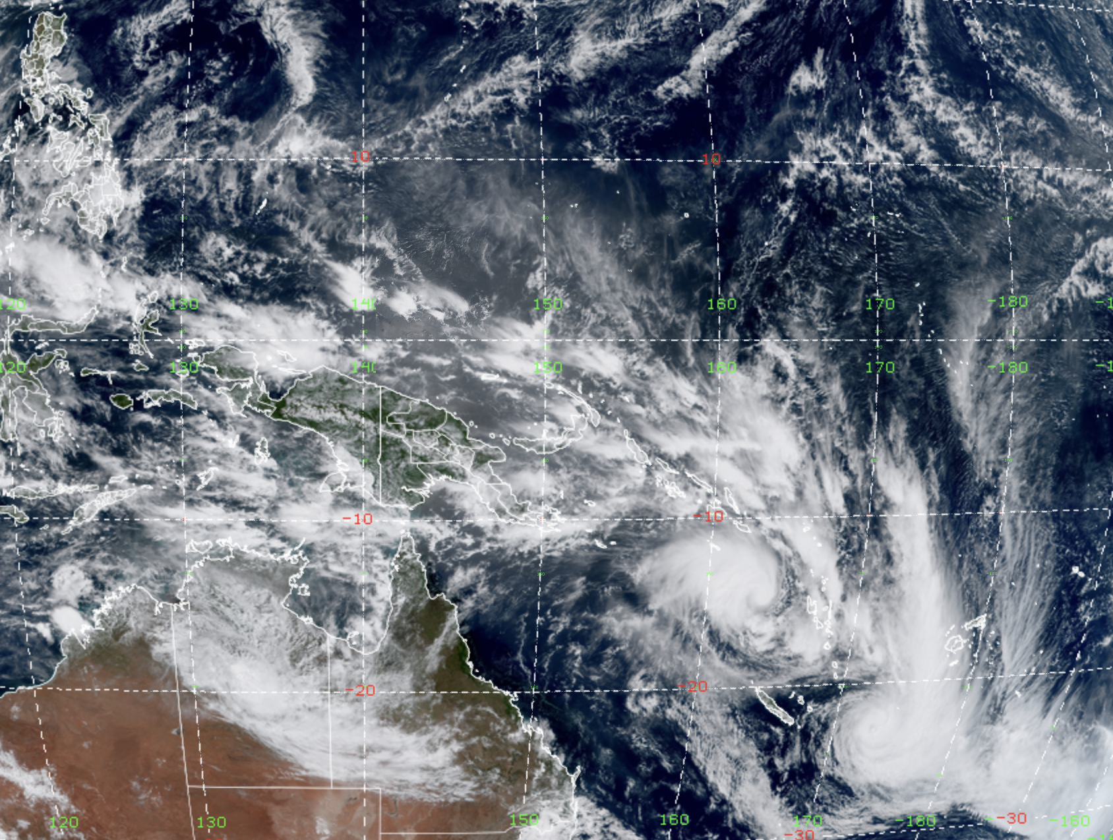
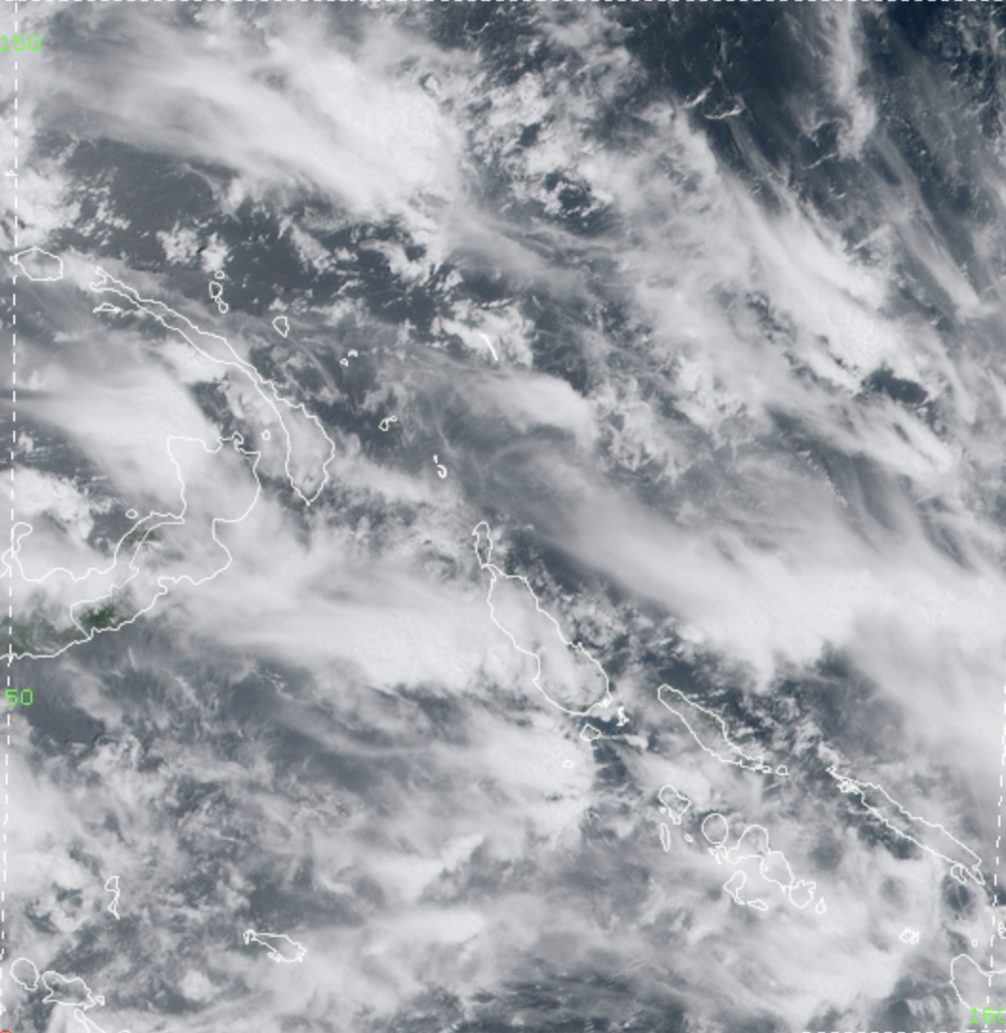
Image from Himawari-9
0200 2 March 2023
(CSU/CIRA)
Notes:
Next, I’ll move on to the core of today’s seminar and start out by showing a color composite visible image from Himawari-9, a Japanese geostationary satellite.
To orient you, we are looking at the West Pacific. In the bottom left, you see Australia, the eastern half of the Maritime Continent above that, and the Philippines in the top left.
There is a lot going on in this image.
You can see tiny clouds that are barely bigger than a pixel.
A couple of cyclones are visible, and there is ample cirrus cloud apparent.
There is a ton of detail in this image, which is made possible by the current generation of instruments aboard satellites like GOES and Himawari.
I’m going to focus your attention to the red box here…

Slide 13
Image from Himawari-9
0200 2 March 2023
(CSU/CIRA)
Notes:
And let’s take a closer look.
Again, you can see a ton of detail.
While this scene is dominated by high-level cirrus cloud that is advected from deep cumulonimbus clouds, we can also see some isolated shallow convection, like this cloud here.

Slide 14
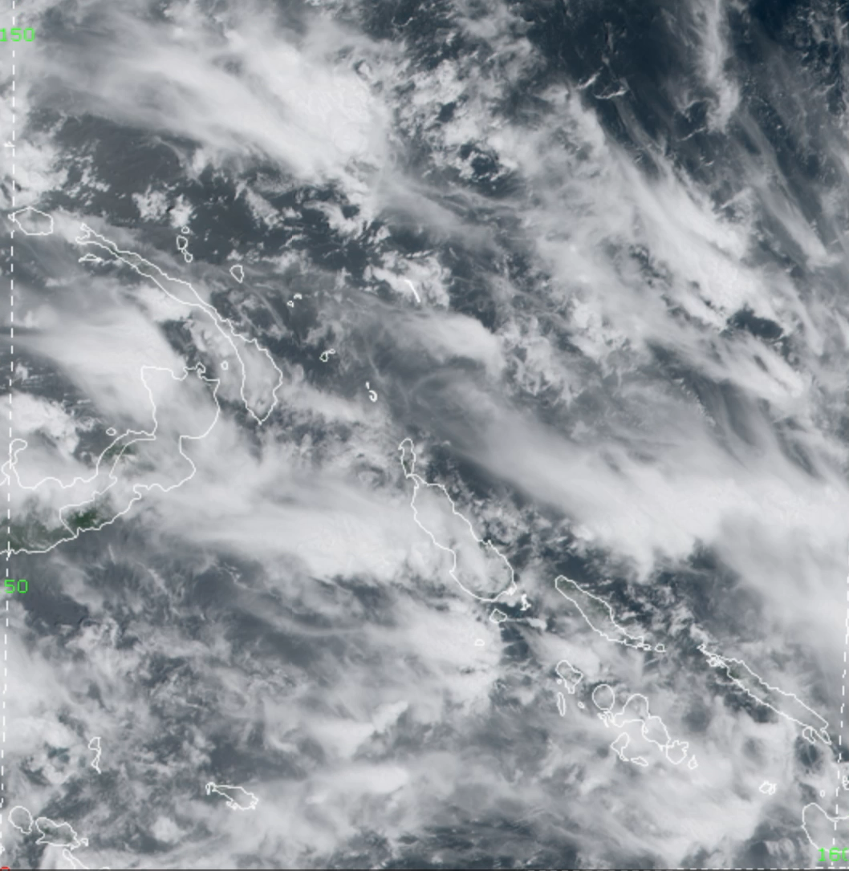
Animation from CSU/CIRA
0200–0400 2 March 2023
Notes:
Next, let’s put this in motion.
Now you’re watching a 2-hour loop of data collected every 10 minutes.
You can see how quickly some of these clouds grow or dissipate and you get a sense of how some of the clouds appear to be somehow organized with one another, while other seem to undergo an entire life cycle by themselves.
One of our biggest problems with numerical prediction of the atmosphere is that we cannot possibly explicitly resolve all of these processes.
We simply do not yet have the technical capability to model the entire globe at a spatial resolution sufficient to capture this myriad of processes, so as a result, we are required to use cumulus parameterizations that attempt to represent the effects of everything you see happening in this image.
I’ve overlaid a faint grid on this imagery, which is about a half-degree by half-degree.
This is coarser than most weather prediction models but in line with what is currently used in operational climate prediction models.
In every box, all of the various smaller-scale processes you see happening basically get boiled down to a few numbers that represent the aggregate effect of all the cloud processes in that box.
This allows us to run models over the whole globe without requiring an infeasible amount of computing resources.

Slide 15
Horizontal Mixing
Radiation
u, v, h
n+1
n
n-1
Moist Convection
m-2 m-1 m m+1 m+2
Planetary Boundary Layer/Turbulence
Surface Model
Microphysics

Slide 16
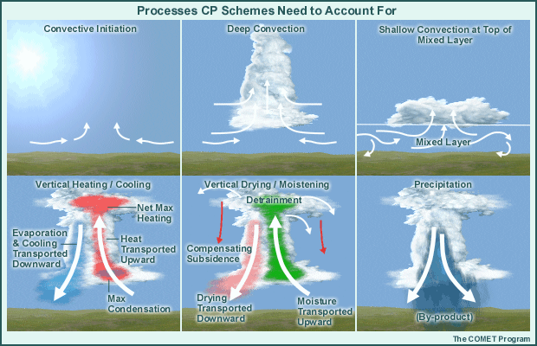
Convective Parameterization
(now more commonly handled by PBL scheme)

Slide 17
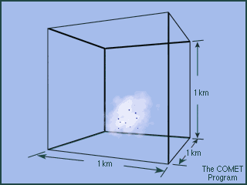
Microphysical Parameterization
Microphysical processes: Even in very high-resolution models, microphysical processes occur on a scale too small to be modeled explicitly.
Typical m³ of cloud has ~10,000,000 drops!
There are important variations in both the horizontal and vertical.
In the animation, condensation and droplet growth are occurring inside a 1-km model grid box

Slide 18
Morrison et al. (2020)

Slide 19
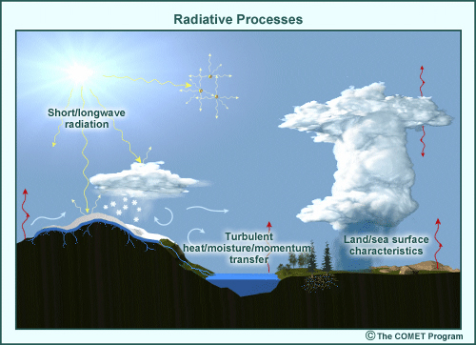
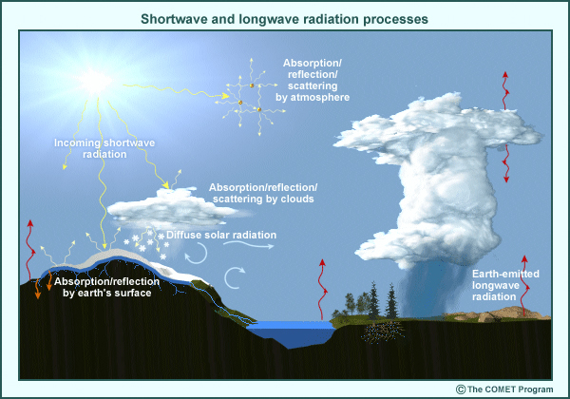
The physics of radiation are unresolvable at grid scales (photons!).
Radiative processes must include:
Shortwave (solar/VIS) and longwave (terrestrial/IR) radiation processes that occur on very small time/space scales and are strongly affected by the local composition of the atmosphere:
Absorption by various gases, clouds, and aerosols.
Reflection and scattering by all gas molecules, clouds, and aerosols.
Land and sea surface characteristics which affect albedo, radiation absorbed or emitted by the surface, evaporation, sensible heating
Exchange of heat, moisture, and momentum between the surface and atmosphere

Slide 20
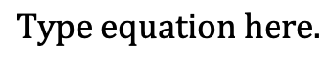

Boundary Layer Parameterization
Mixing caused by eddies of scale ~6Δx and larger is resolved.
Mixing by eddies too small to resolve is “subgrid” mixing and its effects must be parameterized.
We will call subgrid scale eddies turbulence.
$$u=\overline{u}+u^{′}$$
Notes:
Steady part and fluctuating part, where u’ is NOT assumed to be small.

Slide 21
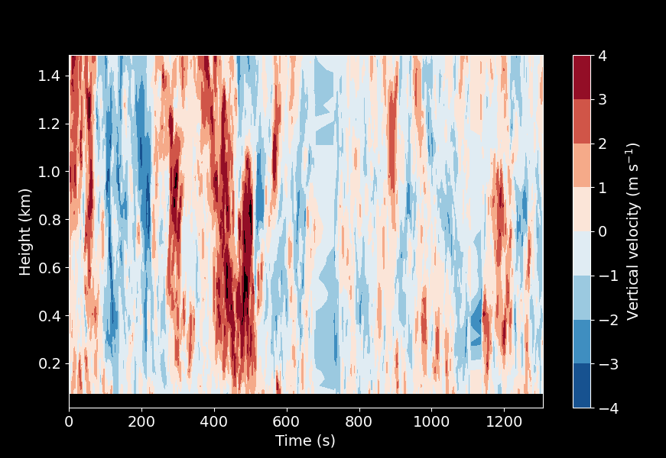
This is what the energy containing portion of real turbulence can look like in the boundary layer from perspective of upward viewing Doppler lidar.
U ≈ 5 m s⁻¹
For flow of 5 m s⁻¹, energy containing eddies are O(100m) across. Not resolved in models or observations.

Slide 22
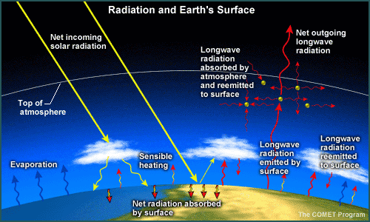
Land Surface Parameterization
Surface processes are important to model properly, because they determine the net surface energy balance, which determines surface temperature and PBL characteristics.

Slide 24
Gravity Wave Drag Parameterization
Numerical models typically require a parameterization for the effects of sub-grid scale gravity waves on the grid-scale flow
Sub-grid-scale orographic or non-orographic gravity waves can propagate vertically and deposit their momentum when then they break. This leads to acceleration or drag on the grid-scale flow
Gravity wave drag parameterization is designed to approximate the effect on the resolved flow of the gravity wave drag that would be generated by unresolved subgrid-scale topography or non-orographic sources in an atmospheric model

Slide 25
Model | Observations
Gridded | Irregular
Resolves only grid scale features; subgrid scales are parameterized | Observation scales vary; may resolve subgrid processes
Balance constraints, maybe including hydrostatic balance | Unconstrained and independent
Consistent with previous model state | No memory of previous observations
Model realistic, but diverges from truth without observations | Real-world measurements with observation and representativeness errors

Slide 26
Three Sources of Information
IMPERFECT
FORECAST
BACKGROUND
ERROR STATISTICS
DESCRIBING
IMPERFECTIONS
IMPERFECT
OBSERVATIONS
Model
Dynamics
and
Physics
Sampled
Reality
Weighting
BEST LINEAR UNBIASED ESTIMATE (BLUE)
OF SYSTEM STATE

Slide 27
Quality Control Does it work? Measure to see.
Verification by self-analysis (42 vs 48 hr. forecasts), see Langland and Baker, 2004 (Tellus).

Slide 28
Quality Control Impact on UKMO UM
Arrow denotes ob from satellite
FSOI and DDE are two metrics that quantify observational impact on forecast error.
Eyre (2021), Metrics for assessing the impact of observations in NWP: a theoretical study. Part I: optimal systems

Slide 29
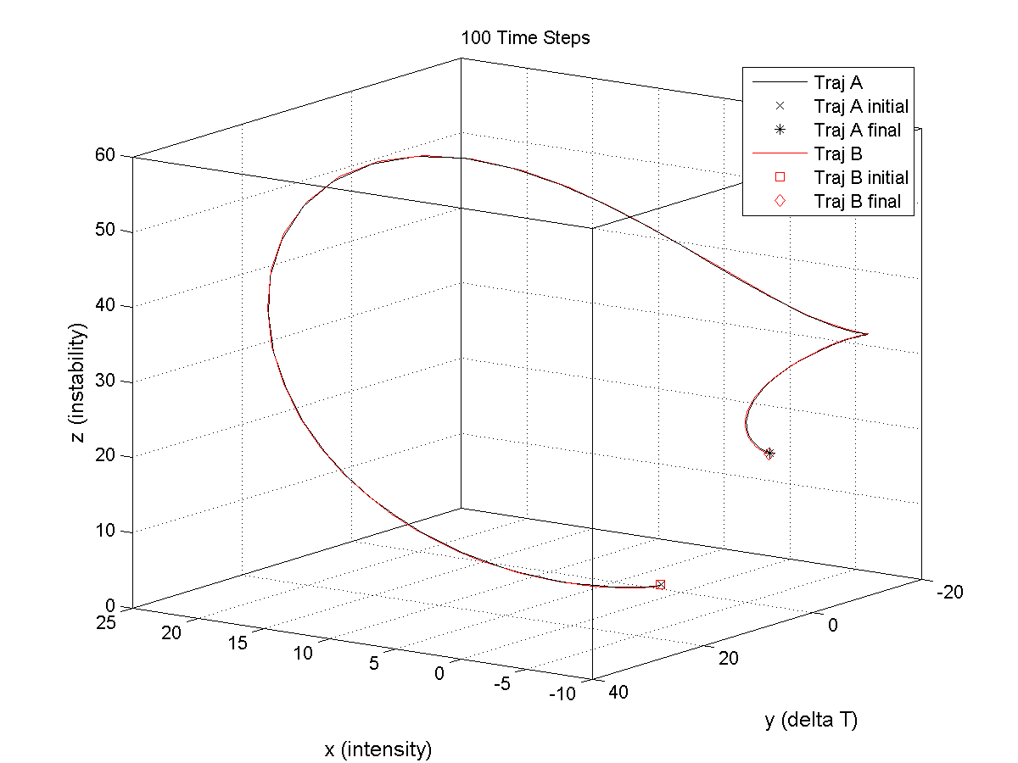
Forecast after 100 time steps
start
Trajectory B starts with slightly different initial conditions than Trajectory A.

Slide 30
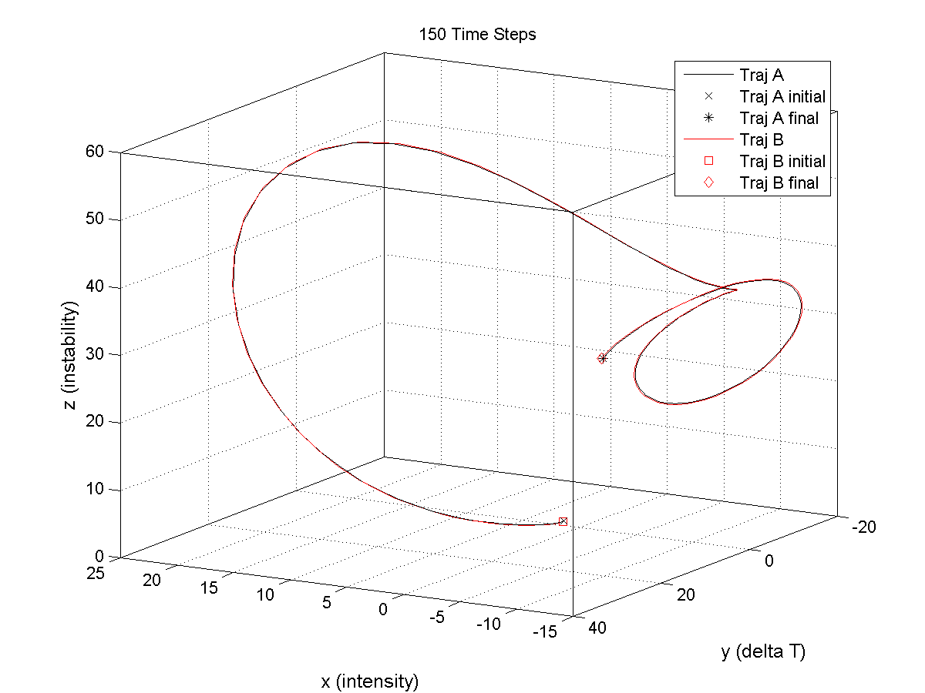
Forecasts are quite similar after 150 time steps
Trajectory B and Trajectory A have similar forecasts.

Slide 31
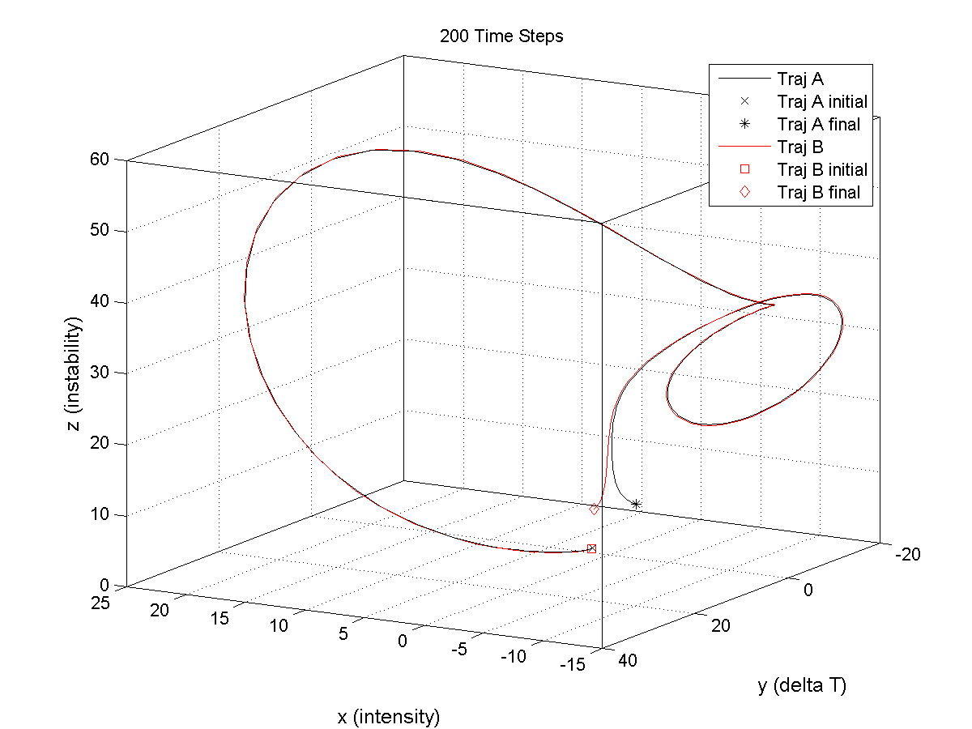
B
A
Region of Sensitivity where the forecasts diverge.
Trajectory B and Trajectory A forecasts are now quite different!

Slide 32
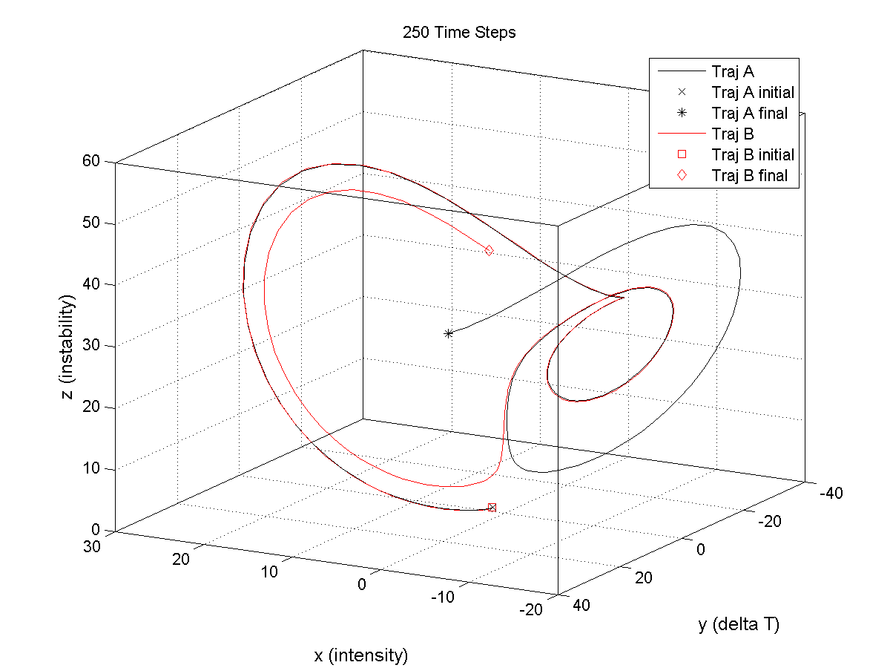

Slide 33
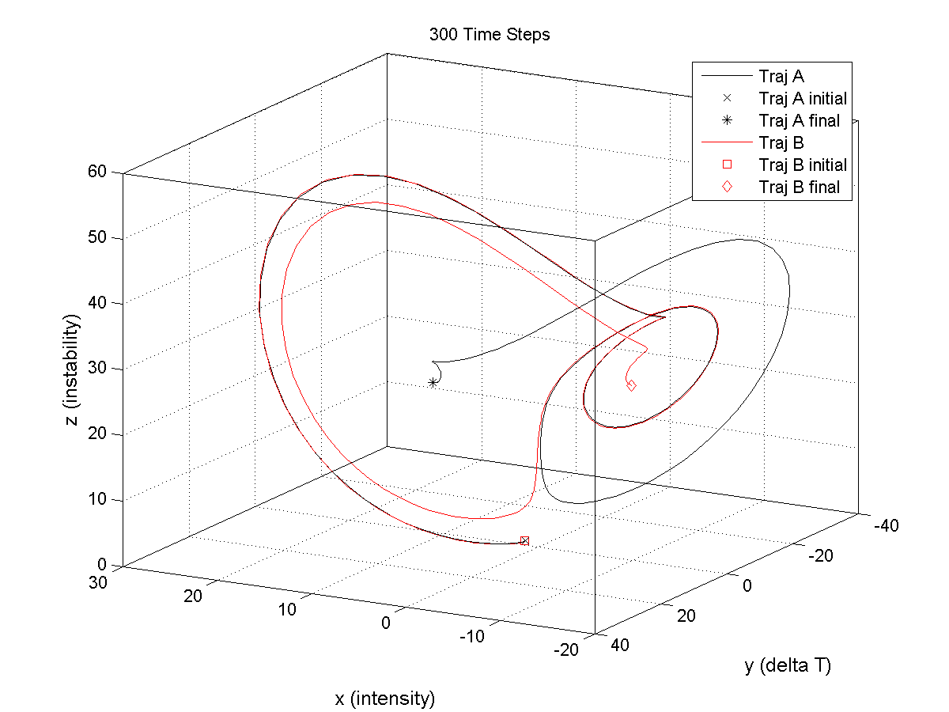

Slide 34
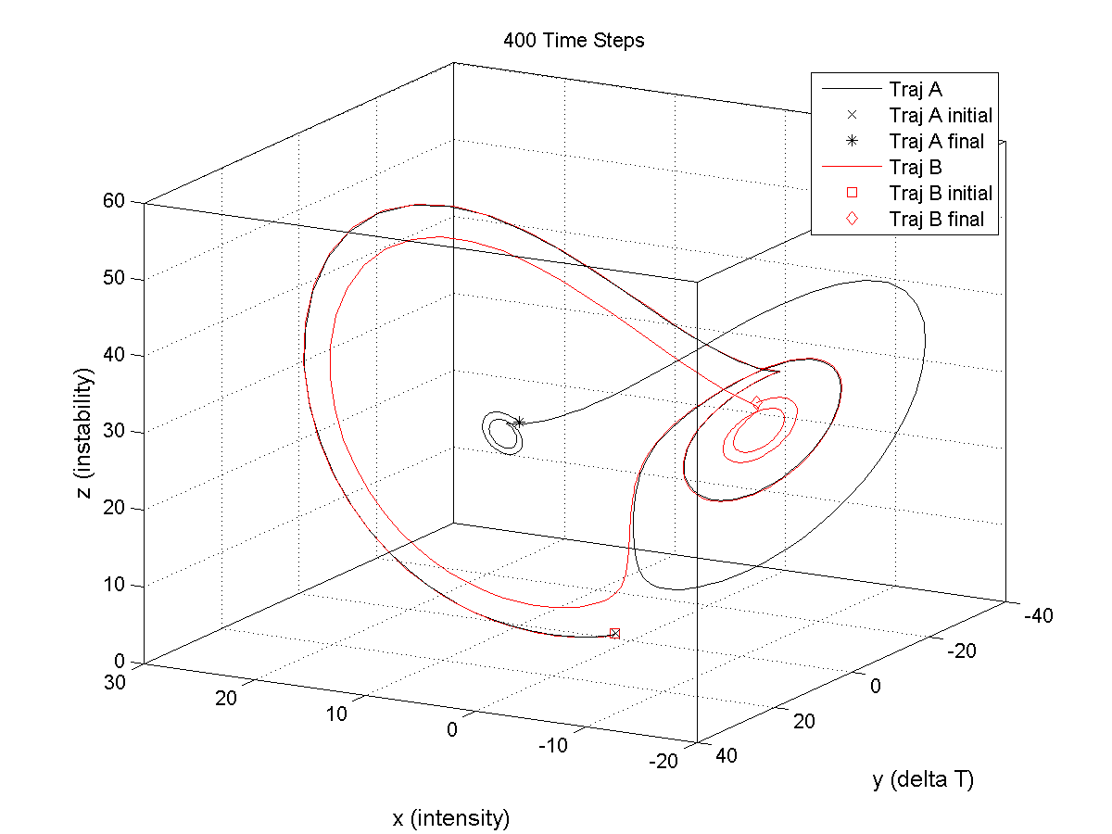

Slide 35
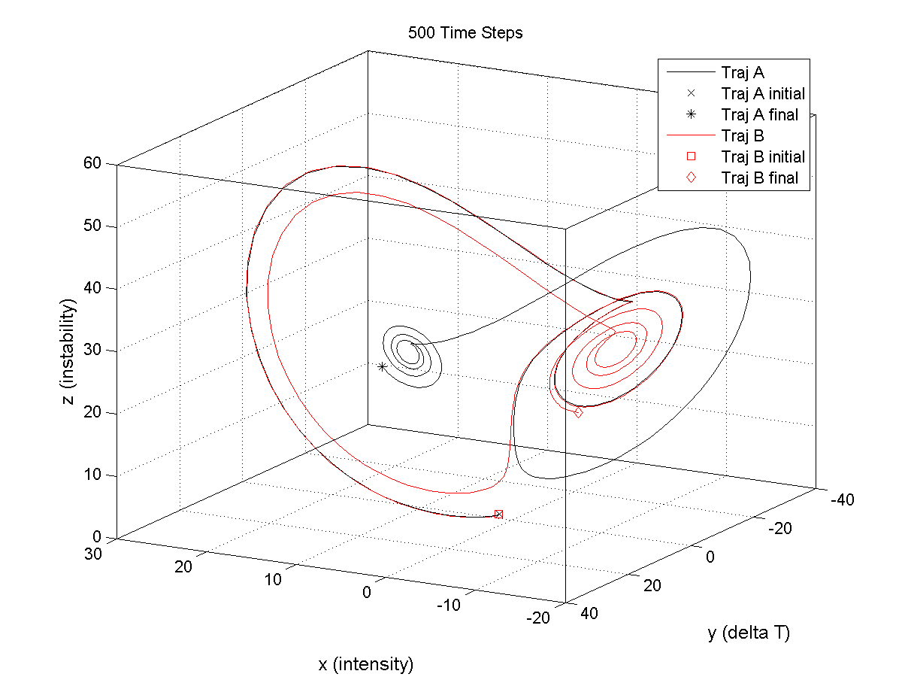

Slide 36
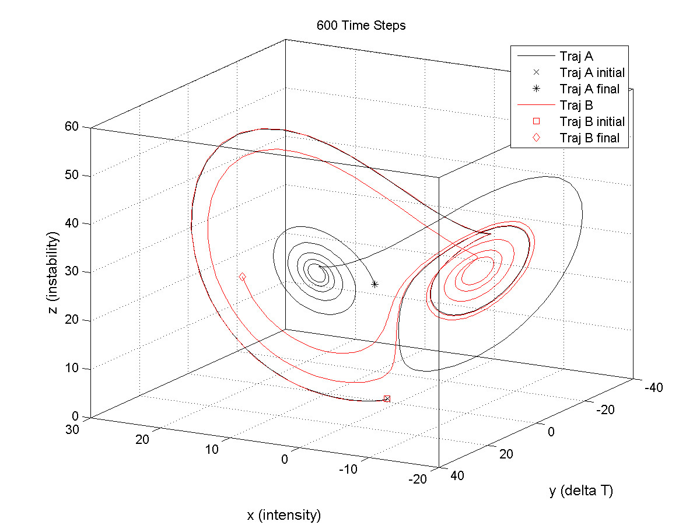

Slide 37
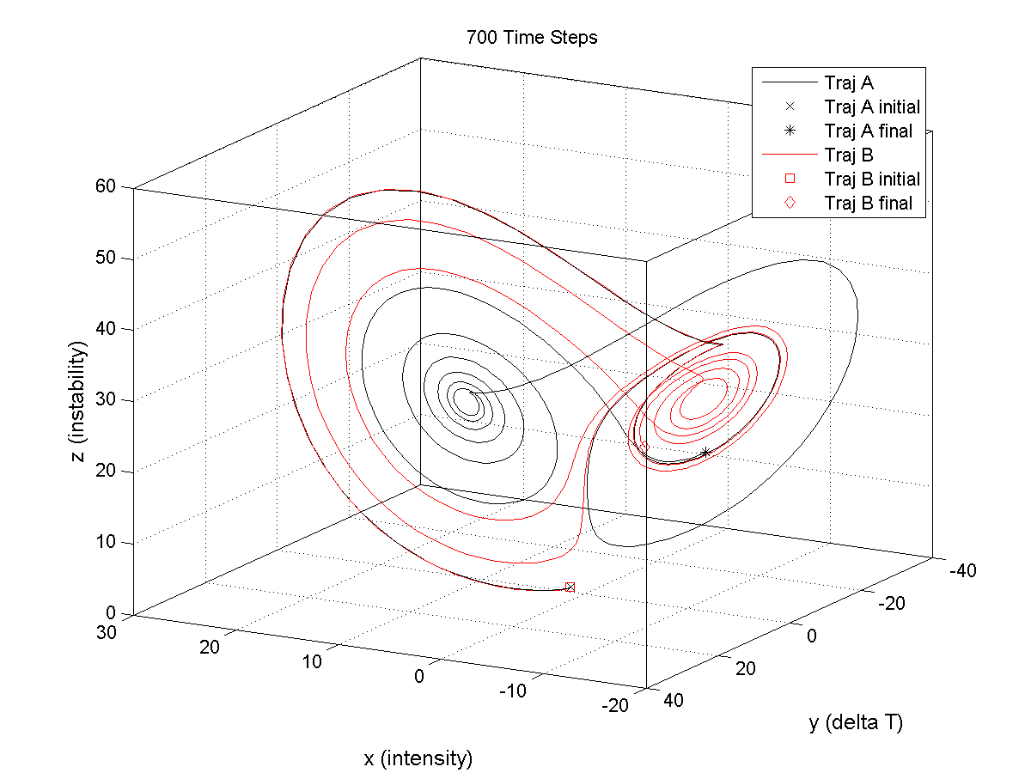

Slide 38
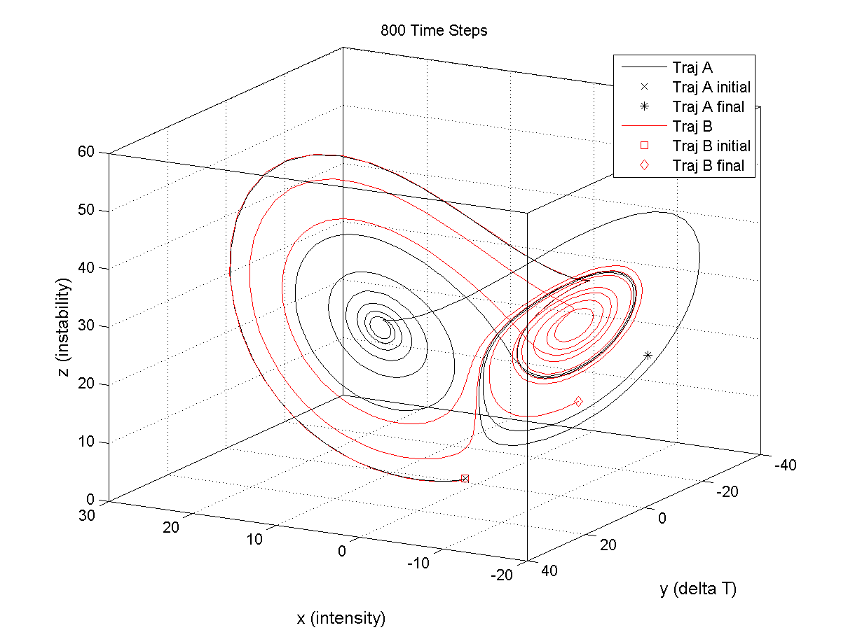

Slide 39
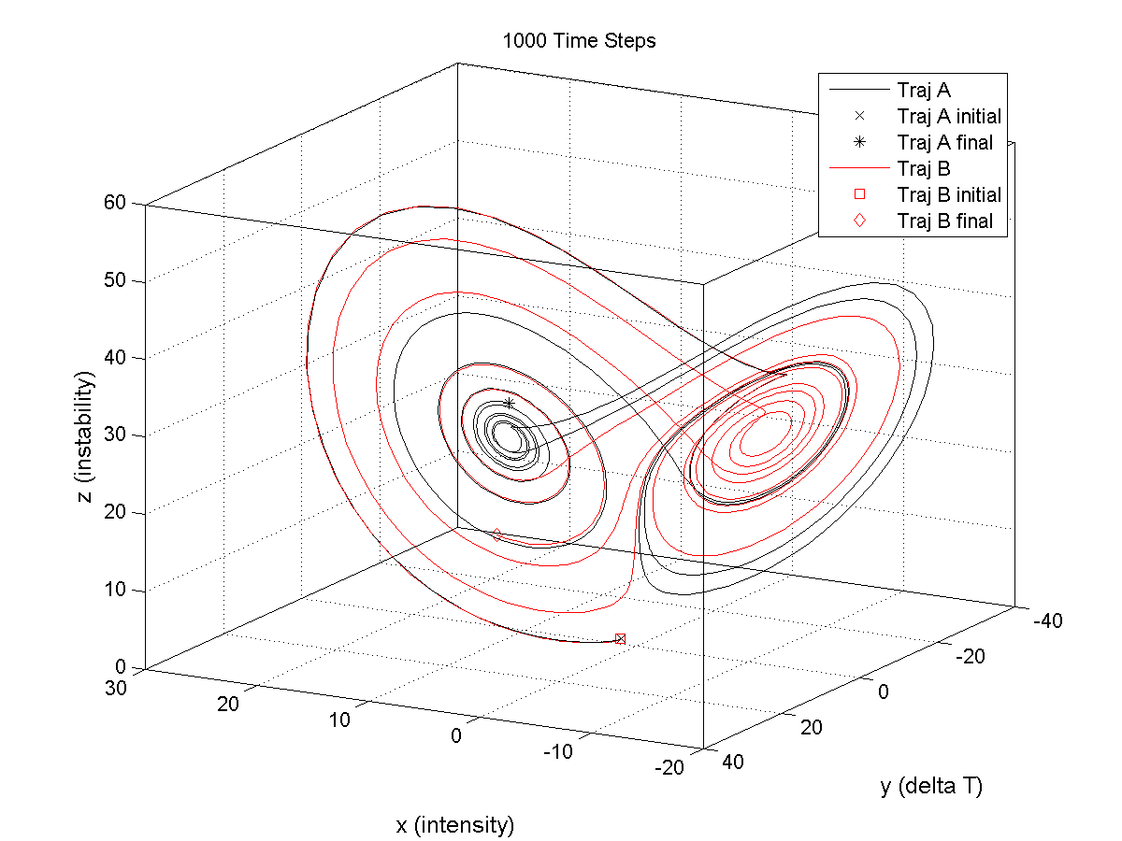

Slide 40
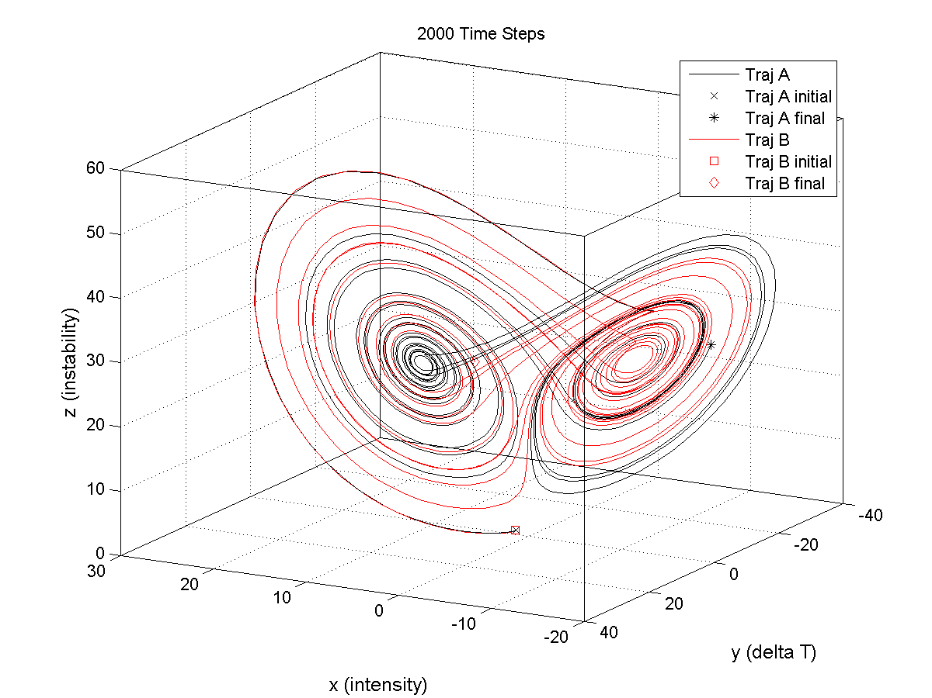

Slide 41
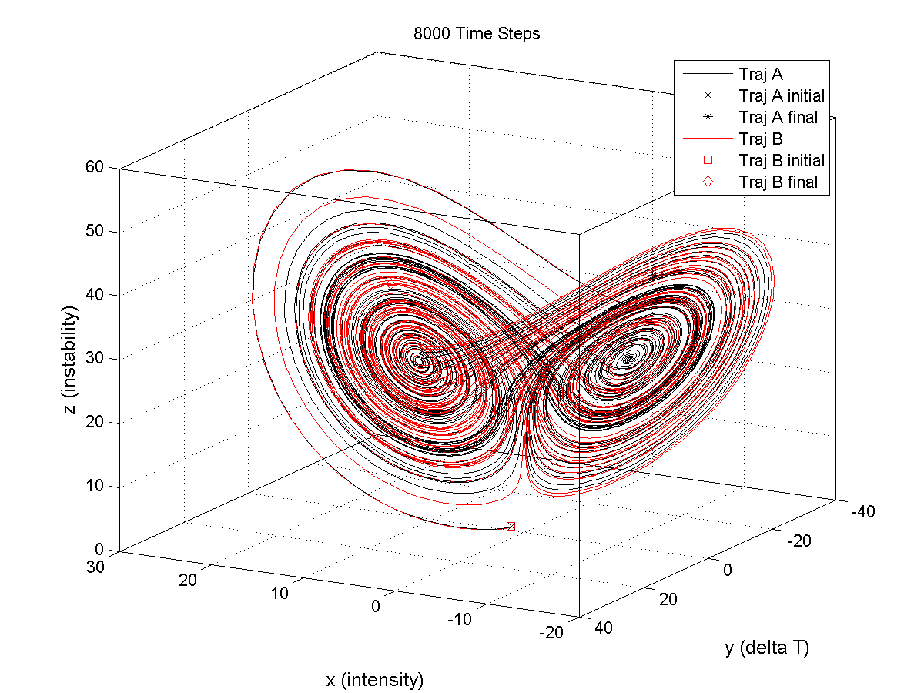

Slide 42






$$\frac{∂u}{∂t}=−u∙∇u+fv −g\frac{∂z}{∂x} − F_{x}$$
$$\frac{∂u}{∂x}+\frac{∂v}{∂y}+\frac{∂ω}{∂p}=0$$
$$\frac{∂v}{∂t}=−u∙∇v−fu −g\frac{∂z}{∂y} − F_{y}$$
$$\frac{∂T}{∂t}=−u∙∇T+ω\frac{RT}{c_{p}p}+ \frac{ℋ}{c_{p}}$$
$$\frac{∂w}{∂t}=−u∙∇w−\frac{1}{ρ_{0}}\frac{∂p^{′}}{∂z}+Bg−gq$$
$$\frac{∂q}{∂t}=−u∙∇q+E−P$$
Large forecast errors can arise out of initially small deviations from truth. In other words, forecast uncertainty is highly sensitive to initial conditions.

Slide 43
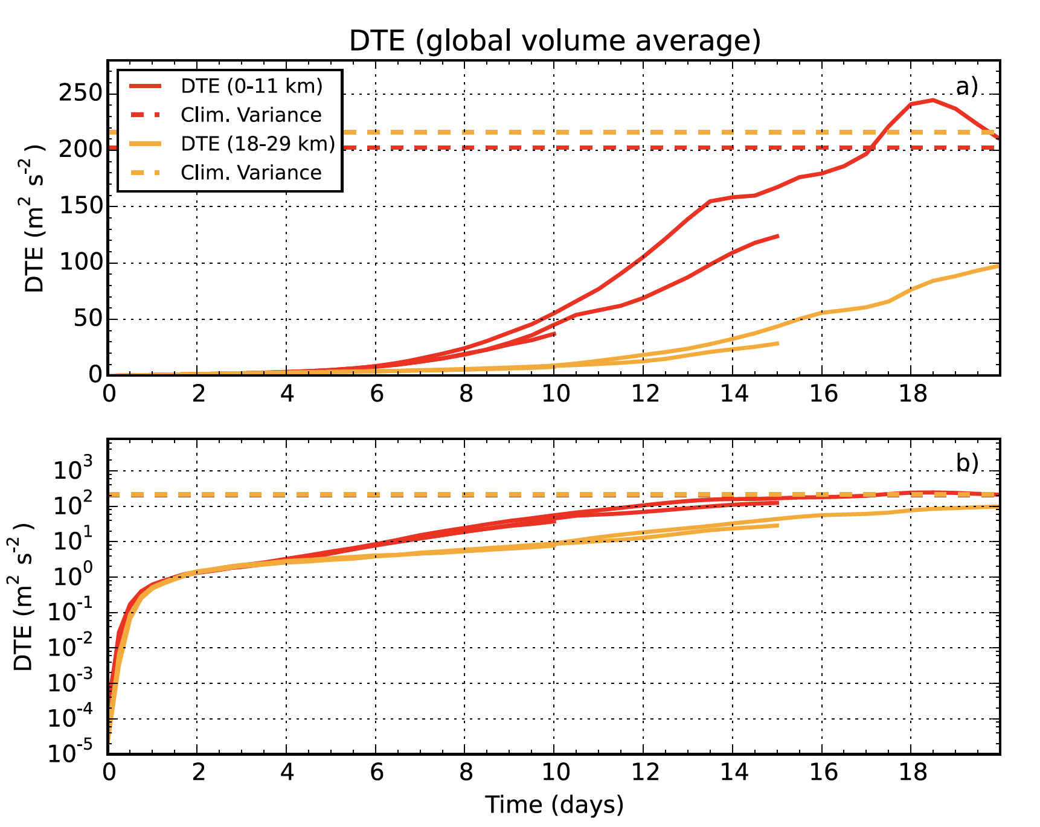
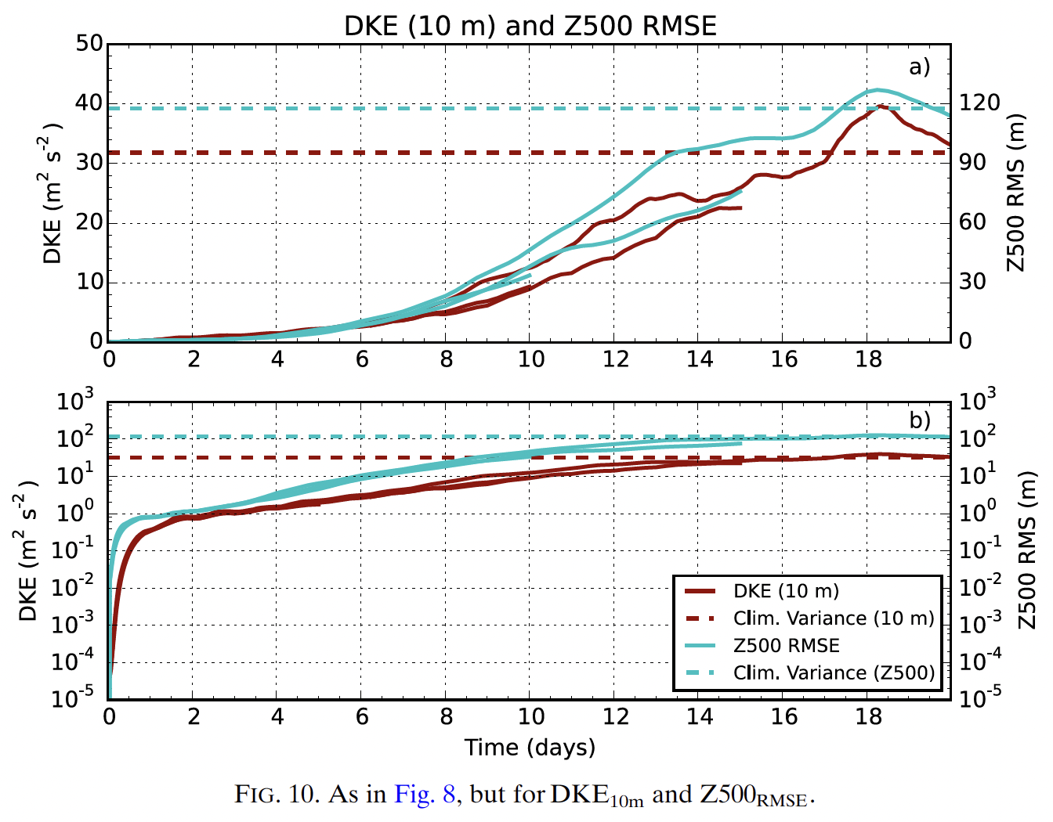
DTE = Difference Total Energy
DKE = Difference Kinetic Energy of 10-m wind
Z500 = 500 mb geopotential height
Modern limits of predictability for NWP systems are between 2 and 3 weeks.
Judt (2018)

